Slide 1
Legacy Effects of Ecological Structure and Hydrologic Function in Pinyon and Juniper Woodlands
Arizona/NASA Space Grant Consortium
Erin Phelps
April 23, 2022
Dr. Jason Williams, SWRC, USDA ARS
Justin Johnson, SWRC, USDA ARS
Pecos National Historic Park

Slide 2
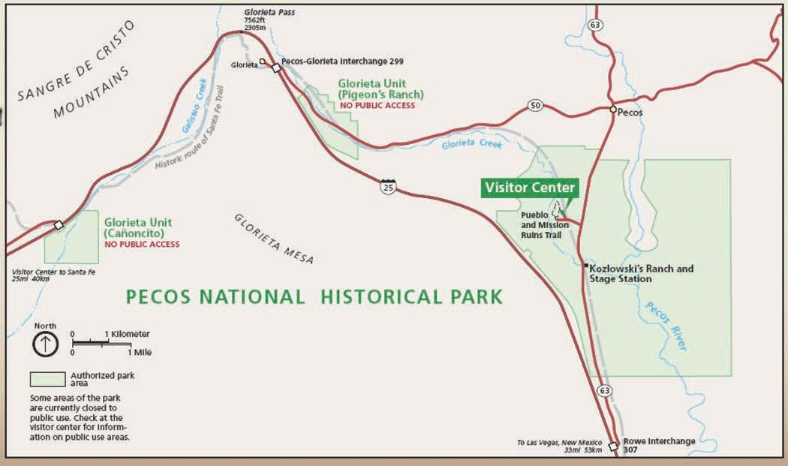
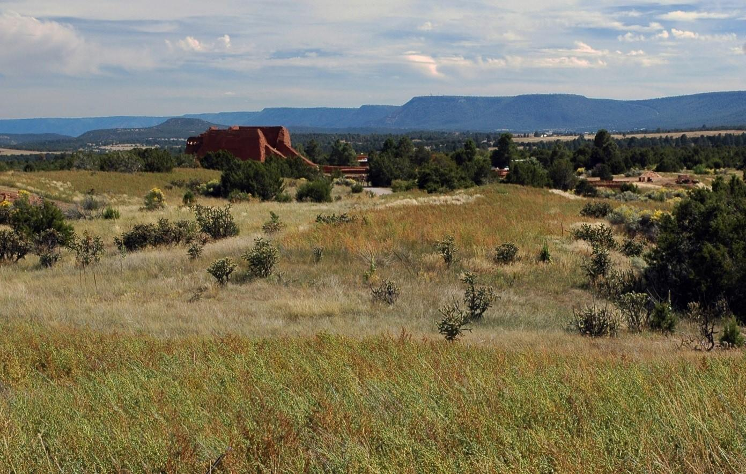
Background & Significance:
My project: Comparing ecological structure and hydrological function of intact woodlands to cleared woodlands → assess eco-hydrologic impacts of tree removal and subsequent infill
Pecos National Historic Park (PNHP):
→Located in Central New Mexico
NPS-PNHP 2022 (in prep.). Pecos National Historical Park Vegetation Management Plan. USDI-NPS, Pecos NHP.

Slide 3
Background & Significance:
My project: Comparing ecological structure and hydrological function of intact woodlands to cleared woodlands → assess eco-hydrologic impacts of tree removal and subsequent infill
Pecos National Historic Park (PNHP):
→Located in Central New Mexico
NPS-PNHP 2022 (in prep.). Pecos National Historical Park Vegetation Management Plan. USDI-NPS, Pecos NHP.

Slide 4
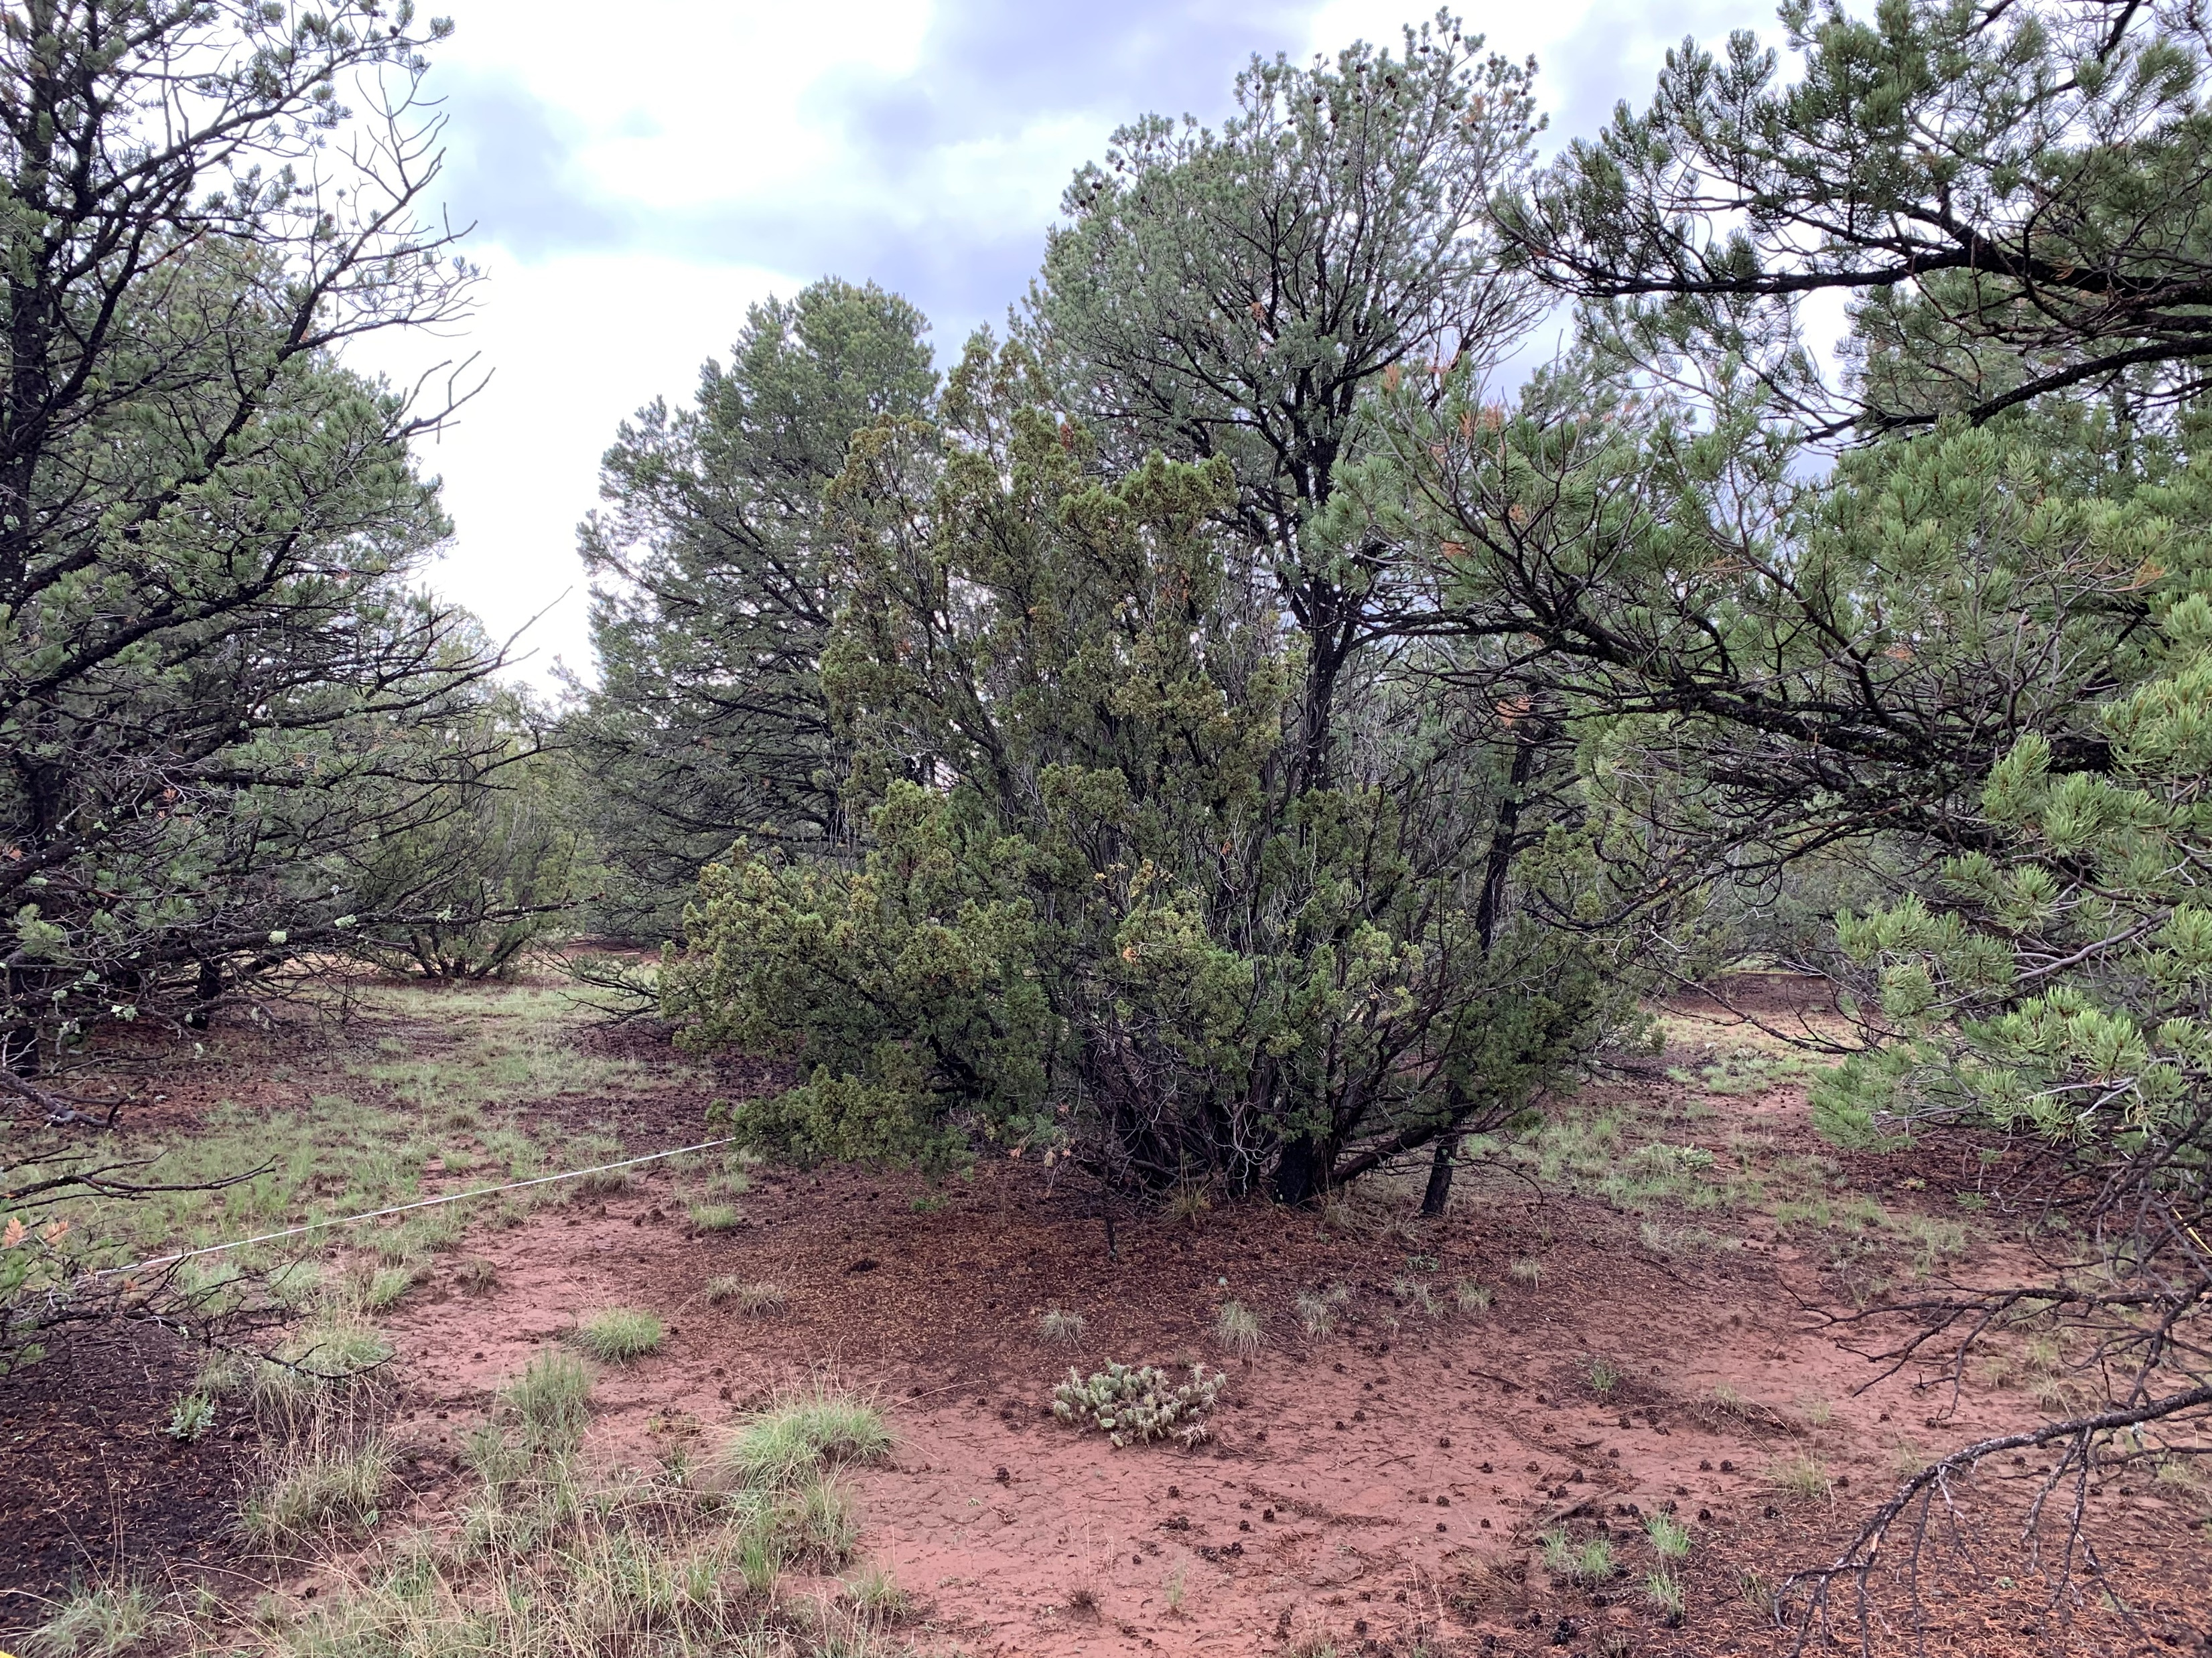
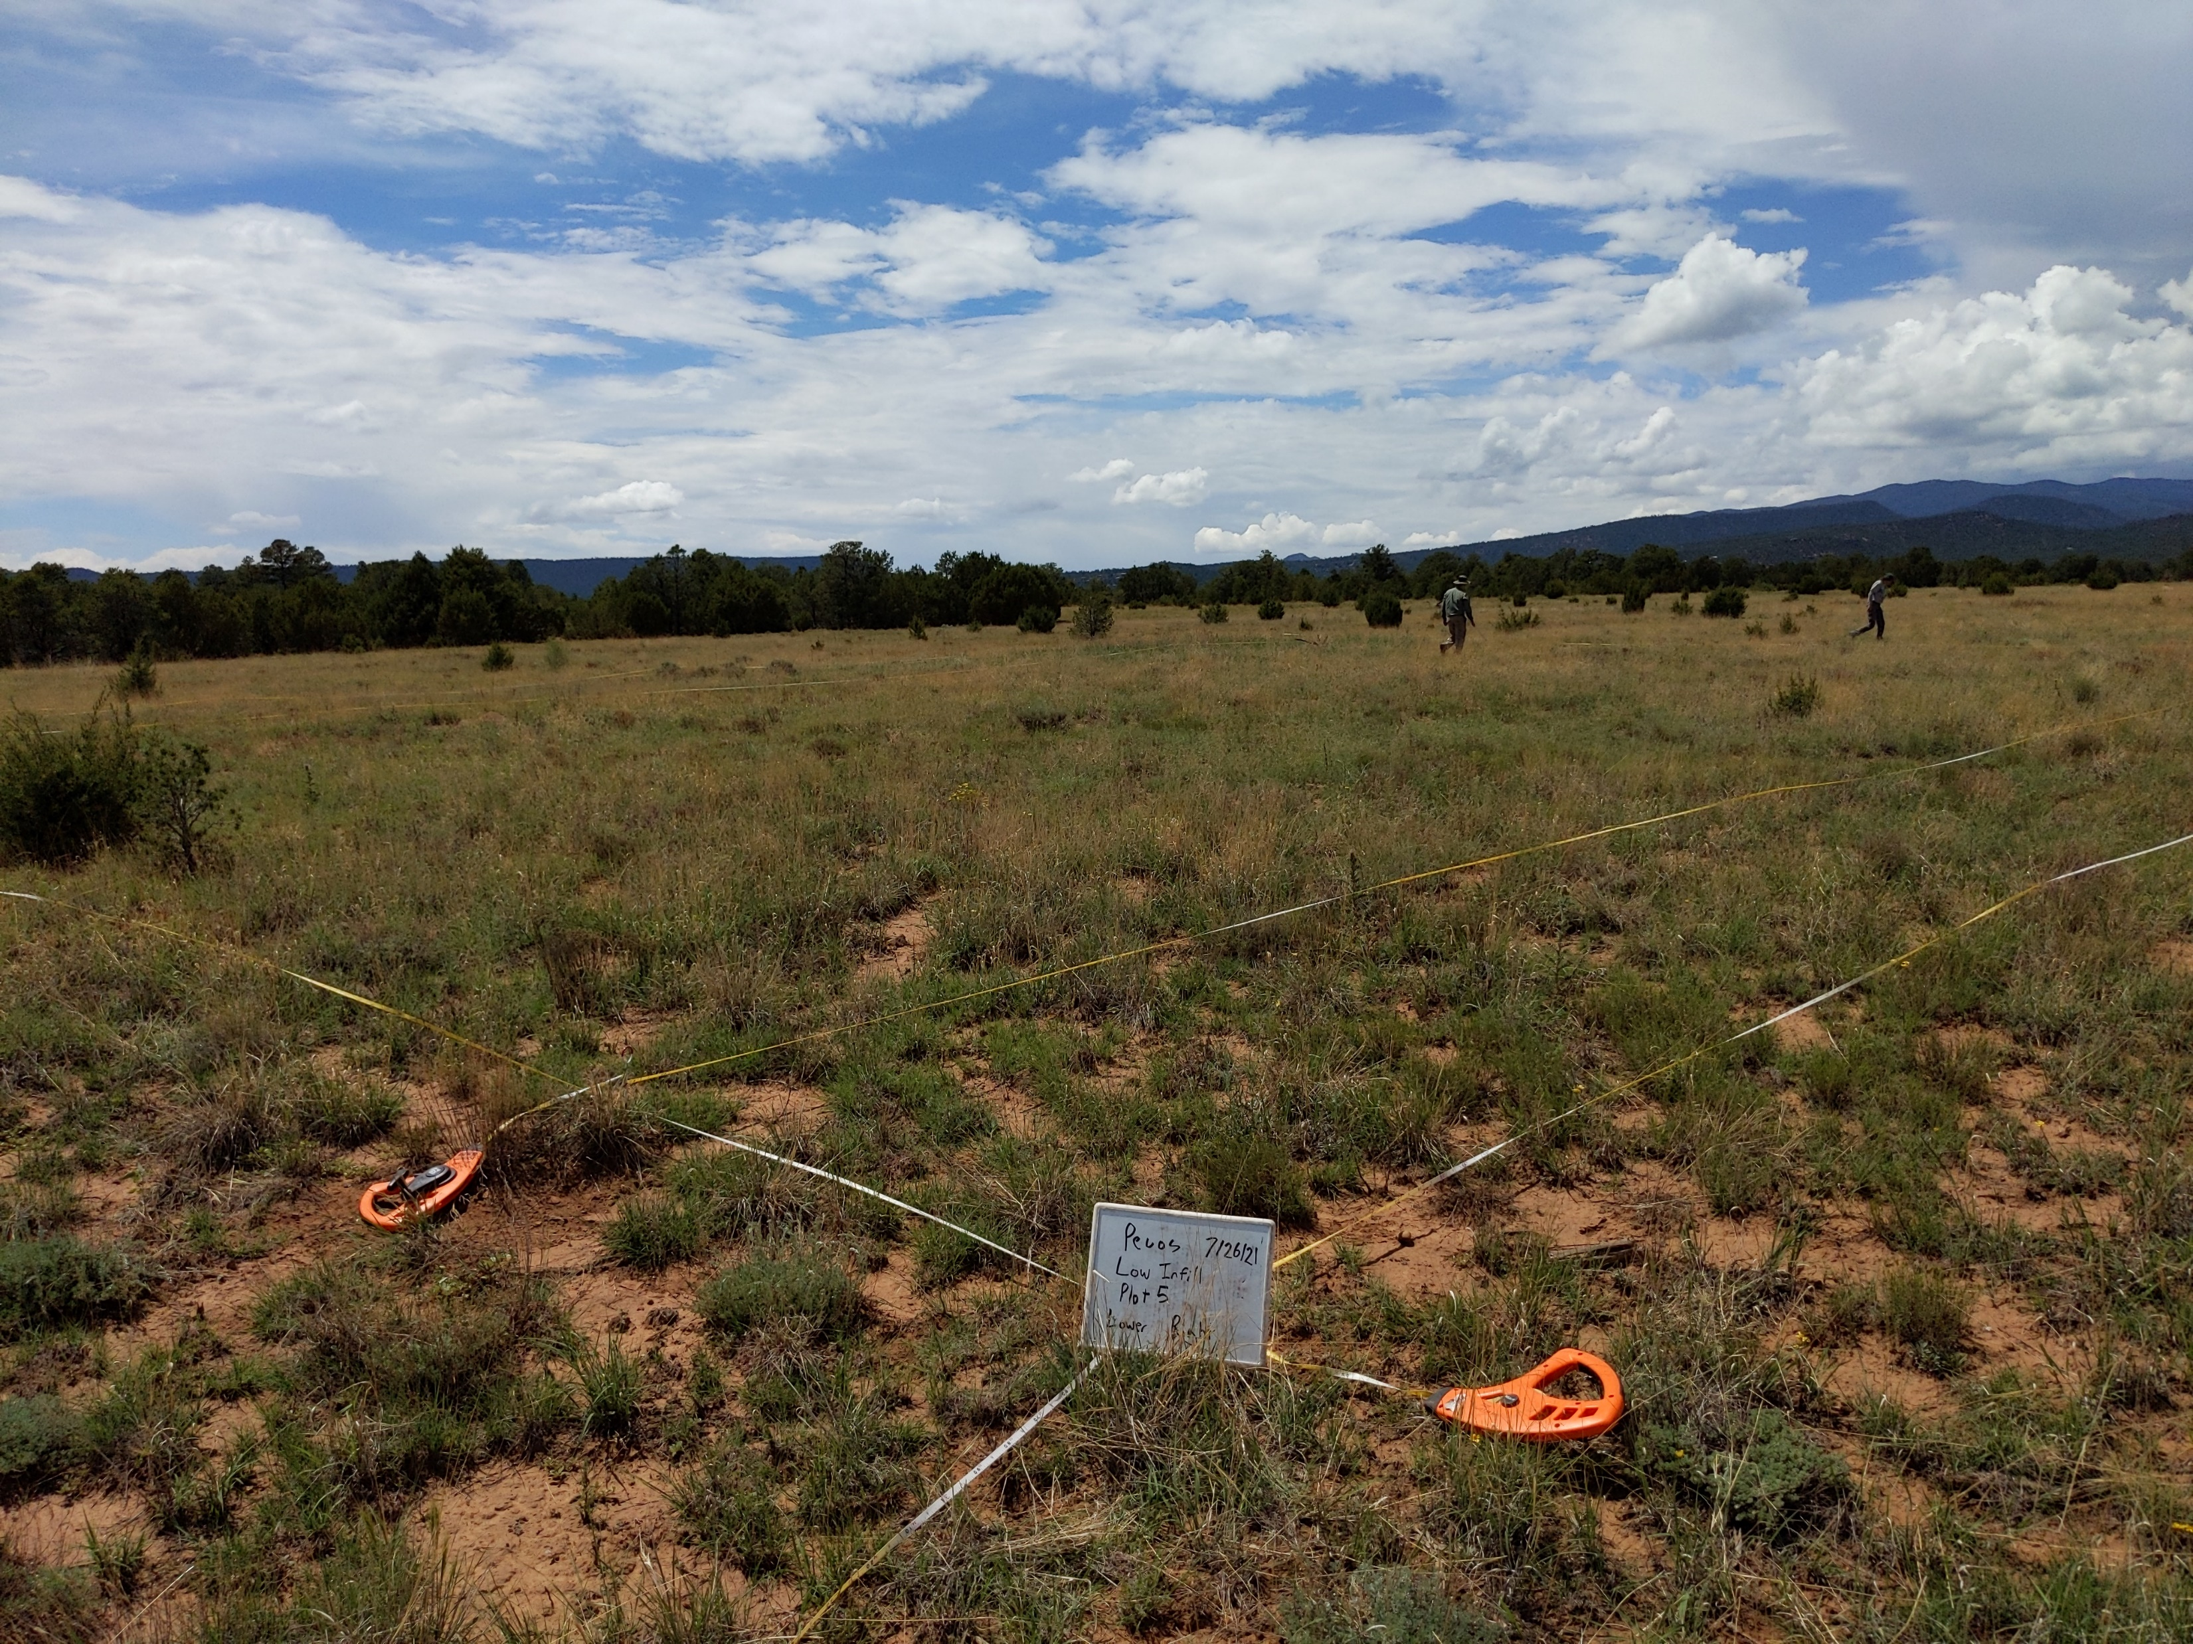
Overarching Goals
Quantitatively characterize the ecological structure and hydrologic function typical of intact woodlands
Assess long-term eco-hydrologic impacts of tree removal and subsequent infill on woodland ecological sites

Slide 5
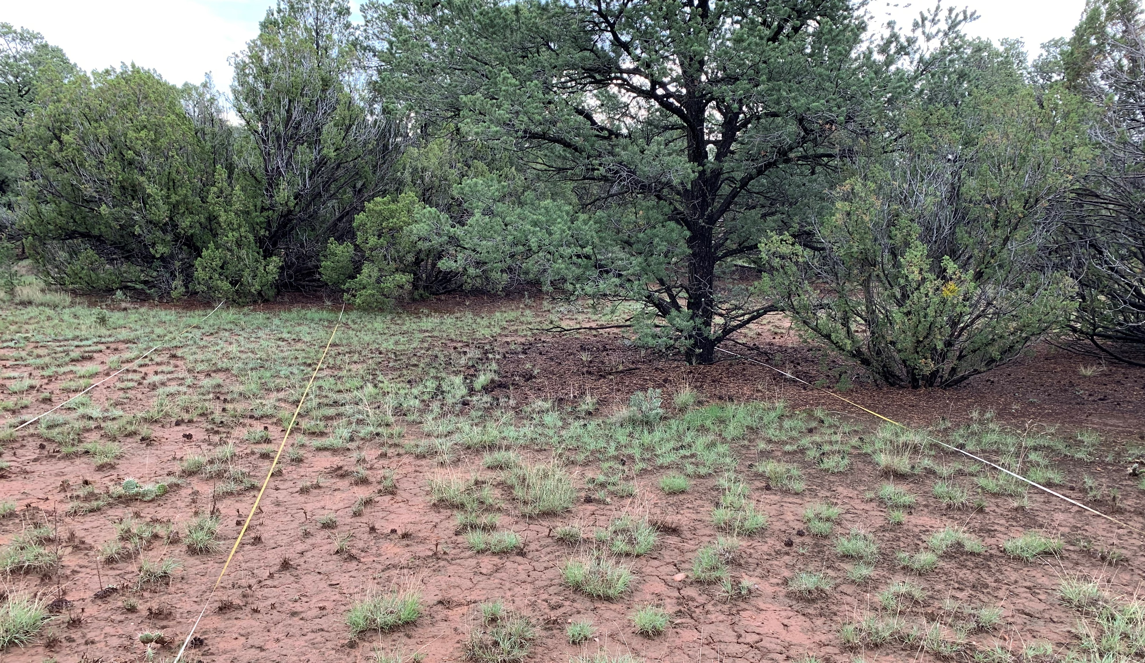
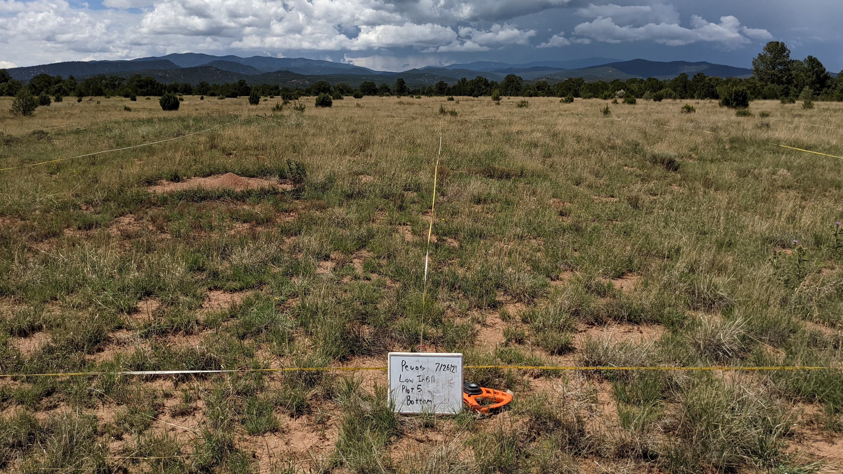
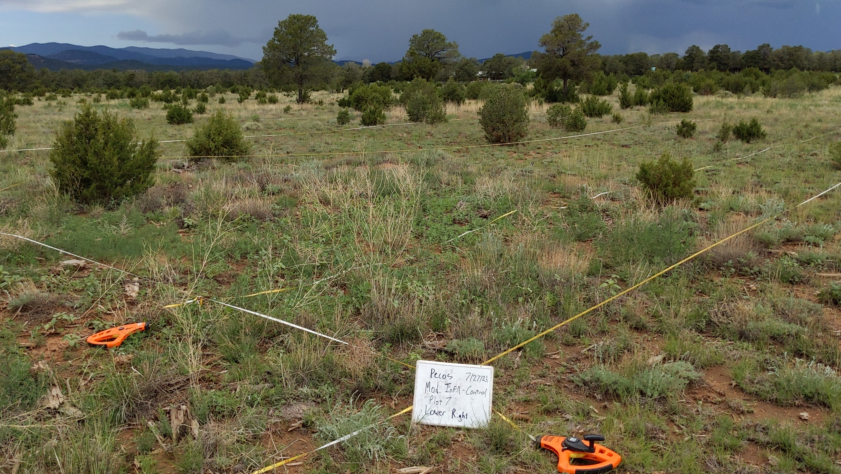
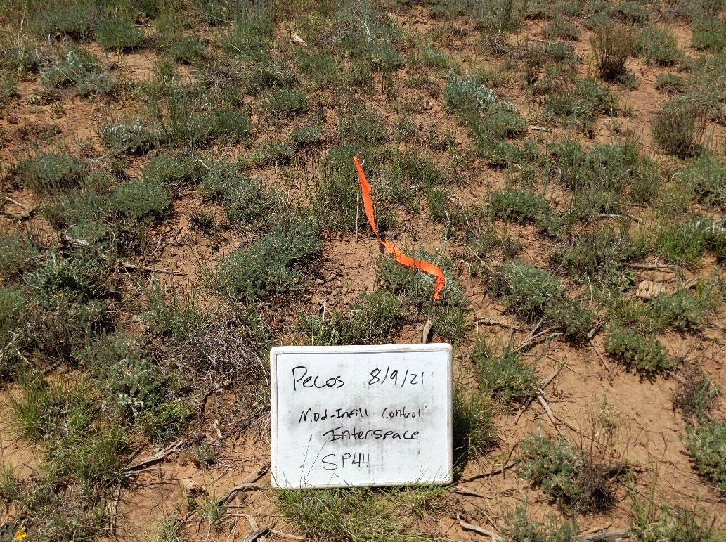
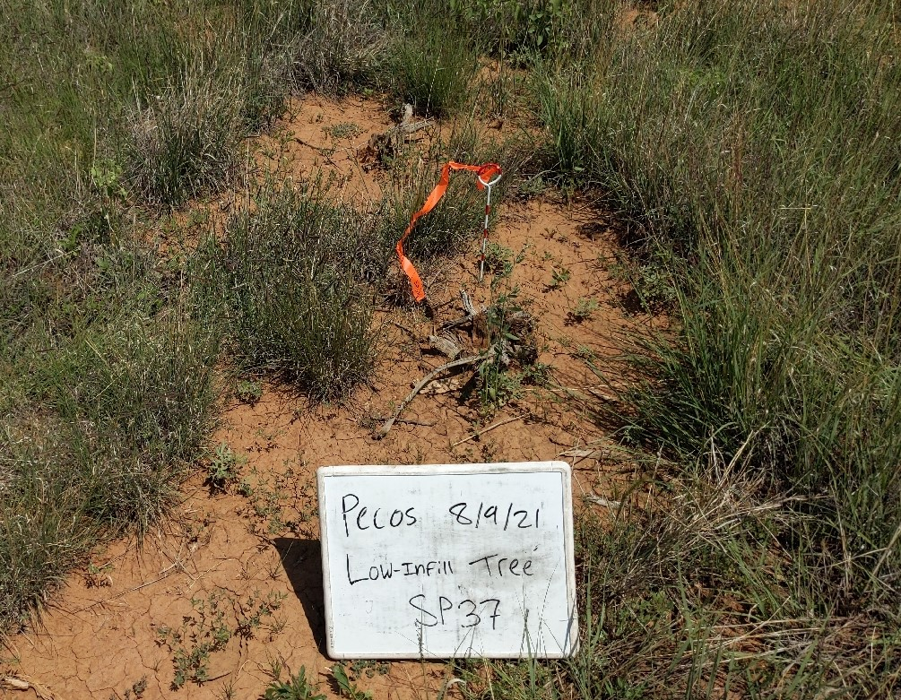
Experimental Design
Three Treatments:
Large Spatial Scale (site characterization) –
12, randomly chosen 30m x 33m plots
Fine Spatial Scale –
Stratified Random Sampling
n=40 tree microsites
n=40 interspace microsites
0.7m x 0.7m plots
Woodland
Low-Infill
Moderate-Infill
Moderate-Infill: Interspace
Low-Infill: Tree

Slide 6
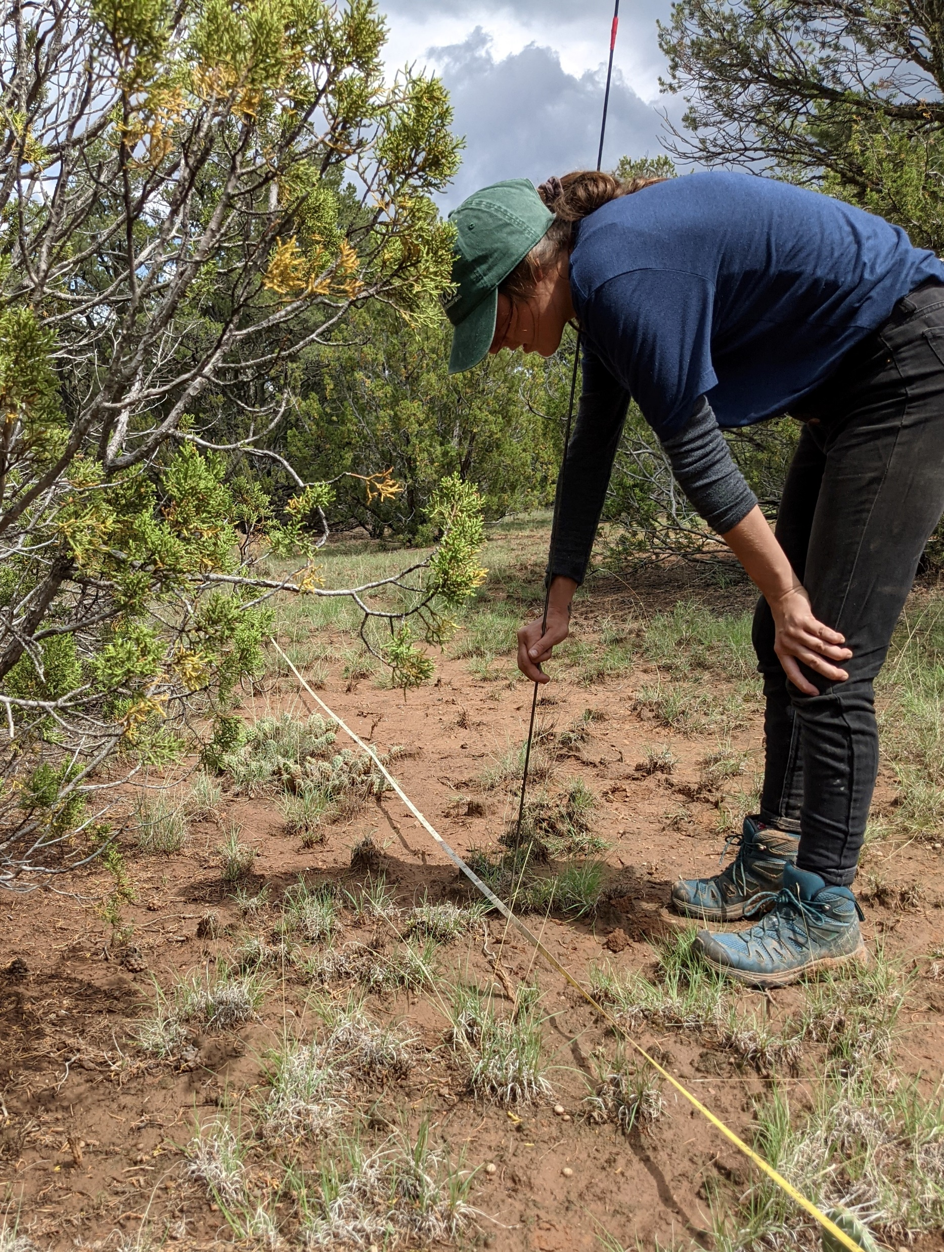
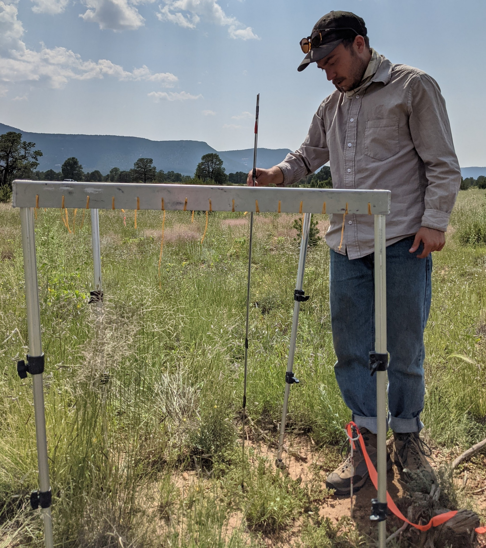
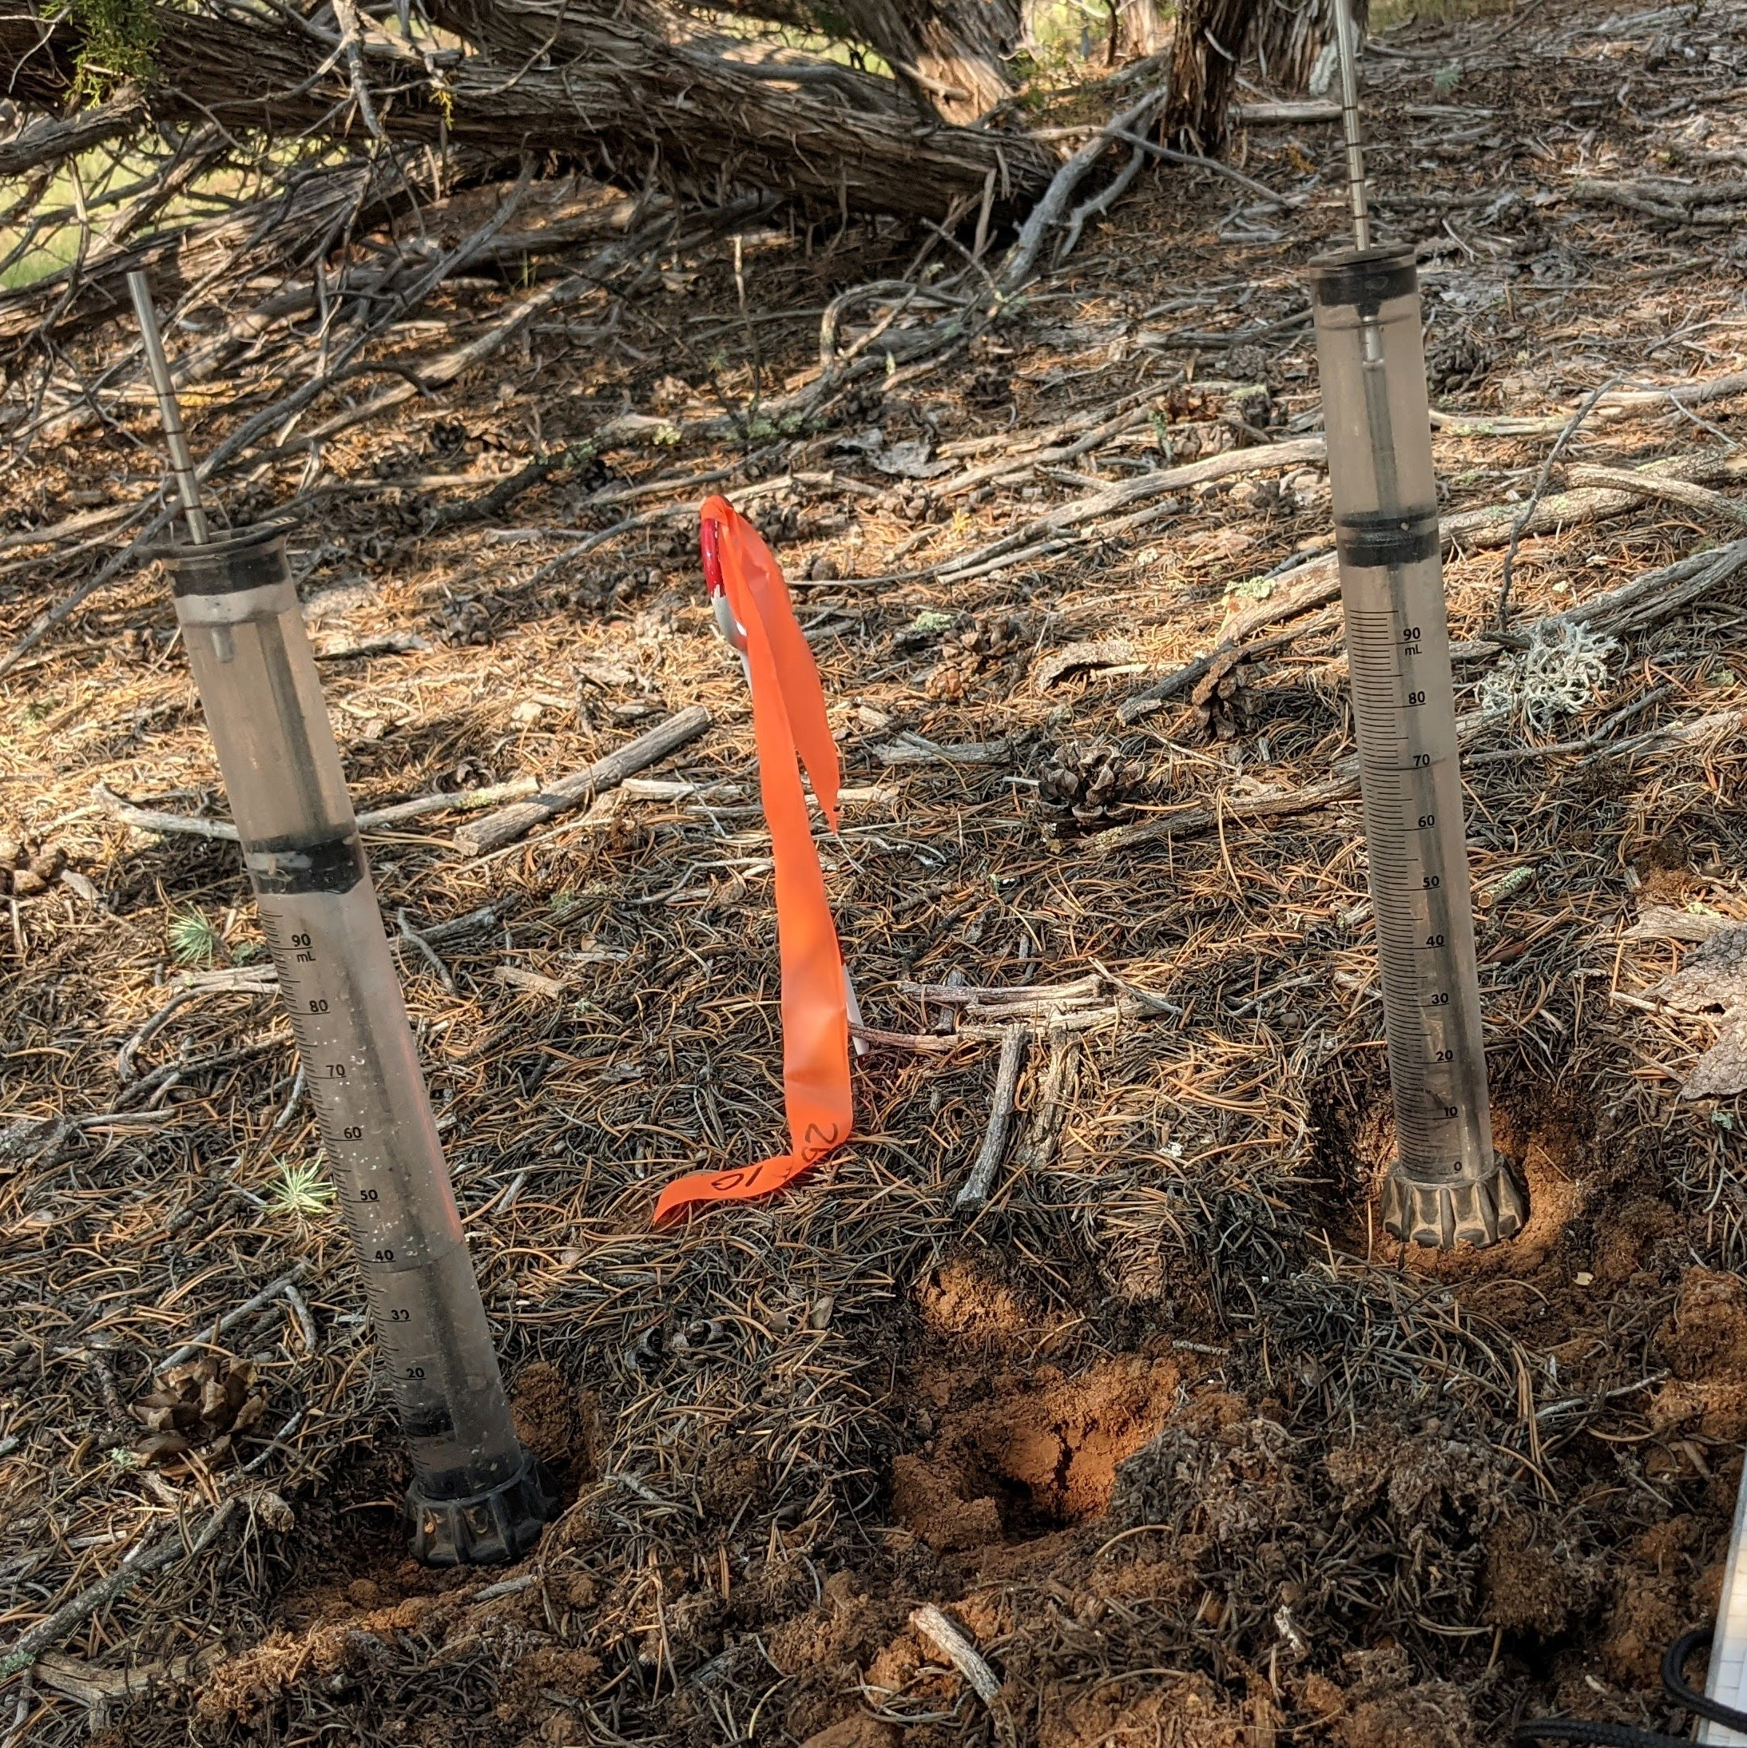
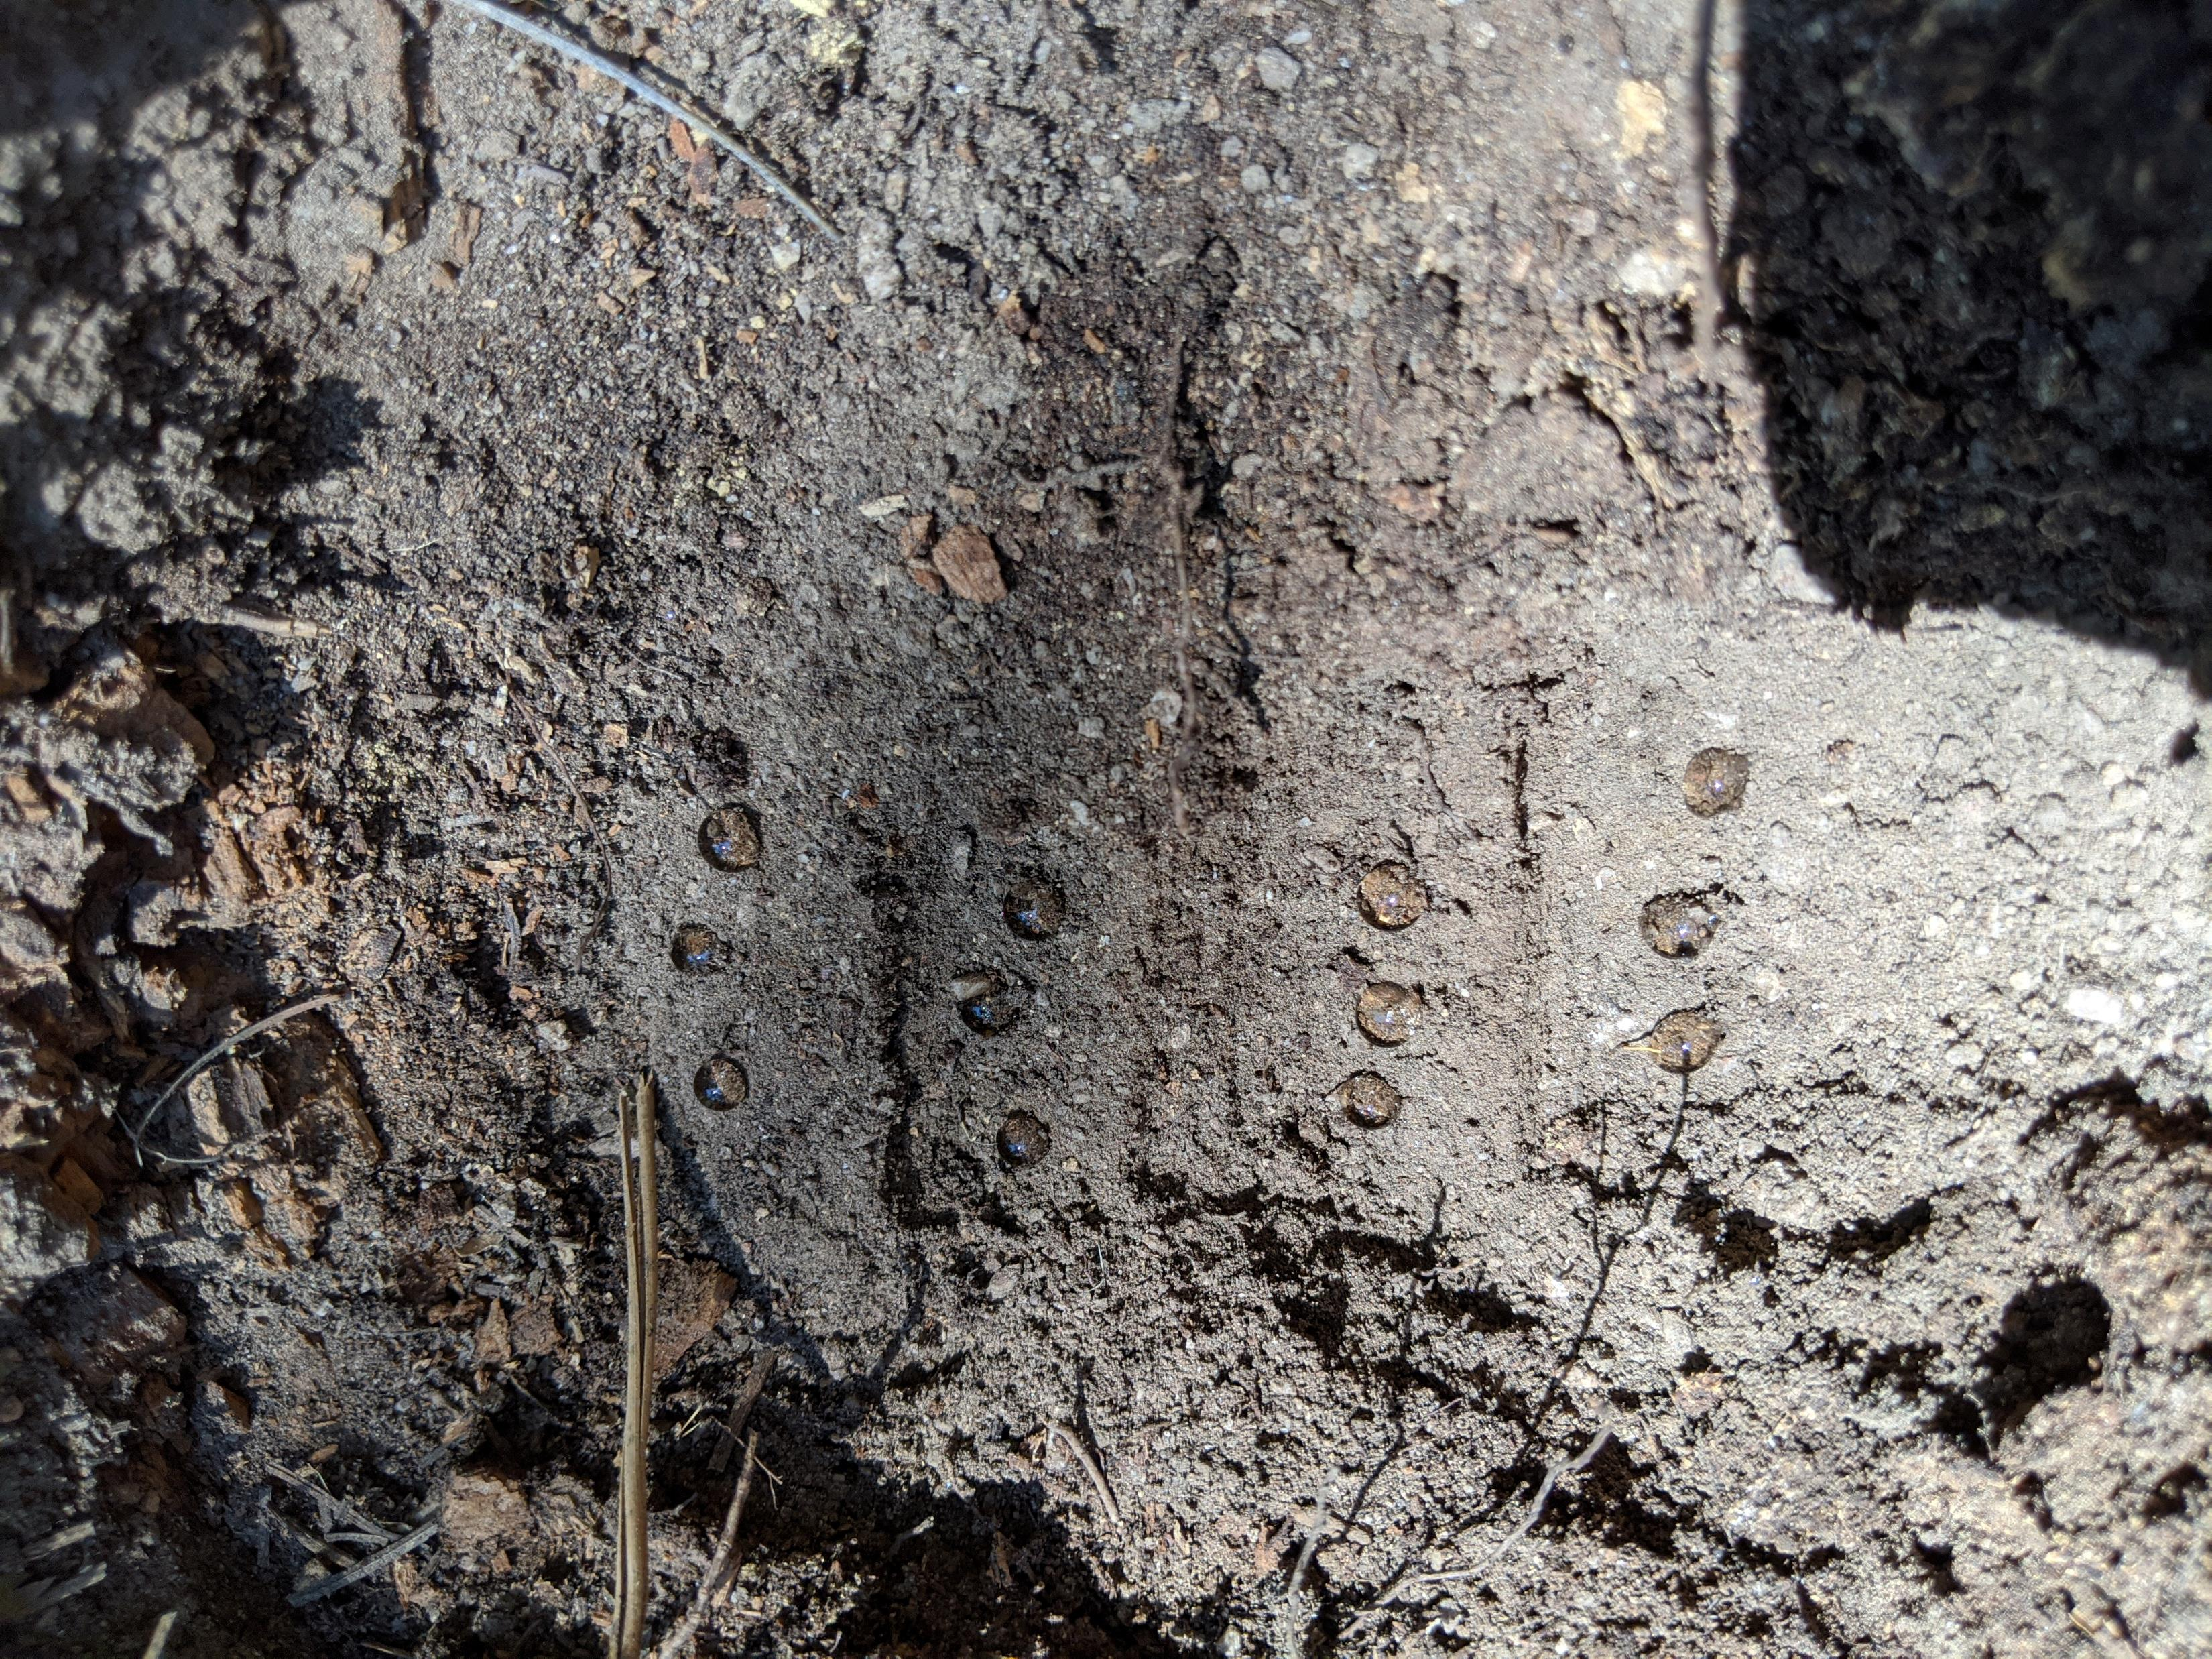
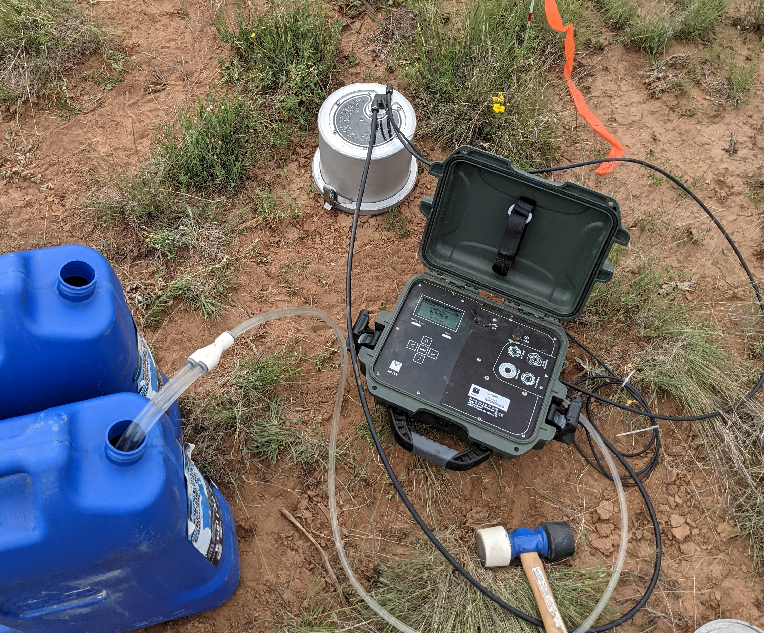
Methods
Large Spatial Scale:
Quantified soil cover
Fine Spatial Scale:
Quantified soil cover
Water Drop Penetration Time Test – measures water repellency (if soils are hydrophobic or not)
Mini Disk Infiltrometer – measures unsaturated hydraulic conductivity
Dual Head Infiltrometer – measures saturated hydraulic conductivity (n=23)

Slide 7
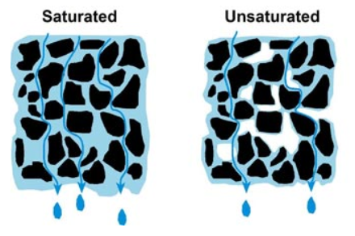
Methods
Large Spatial Scale:
Quantified soil cover
Fine Spatial Scale:
Quantified soil cover
Water Drop Penetration Time Test – measures water repellency (if soils are hydrophobic or not)
Mini Disk Infiltrometer – measures unsaturated hydraulic conductivity
Dual Head Infiltrometer – measures saturated hydraulic conductivity (n=23)
Soil Hydraulic Conductivity: the ability of water to pass through the pores
Triantafilis, John. “Water Flow.” Terragis Soil, http://www.terragis.bees.unsw.edu.au/terraGIS_soil/sp_water-water_flow.html.

Slide 8
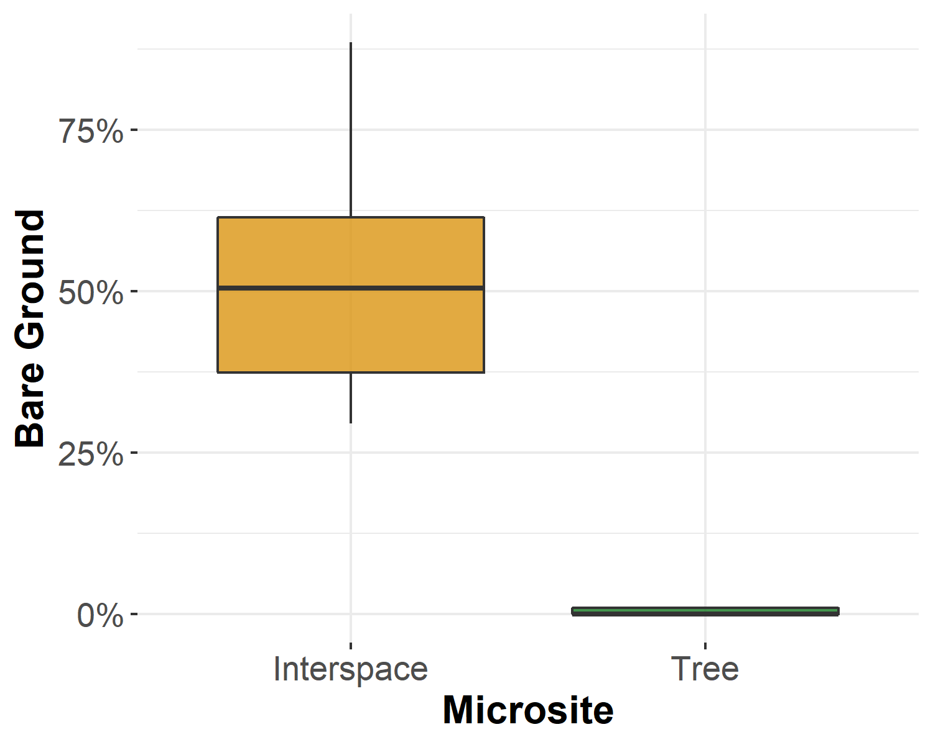
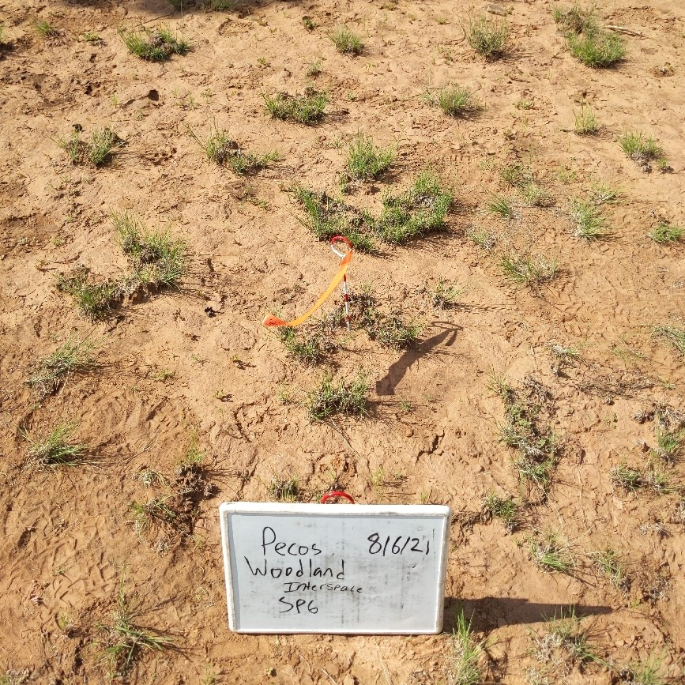
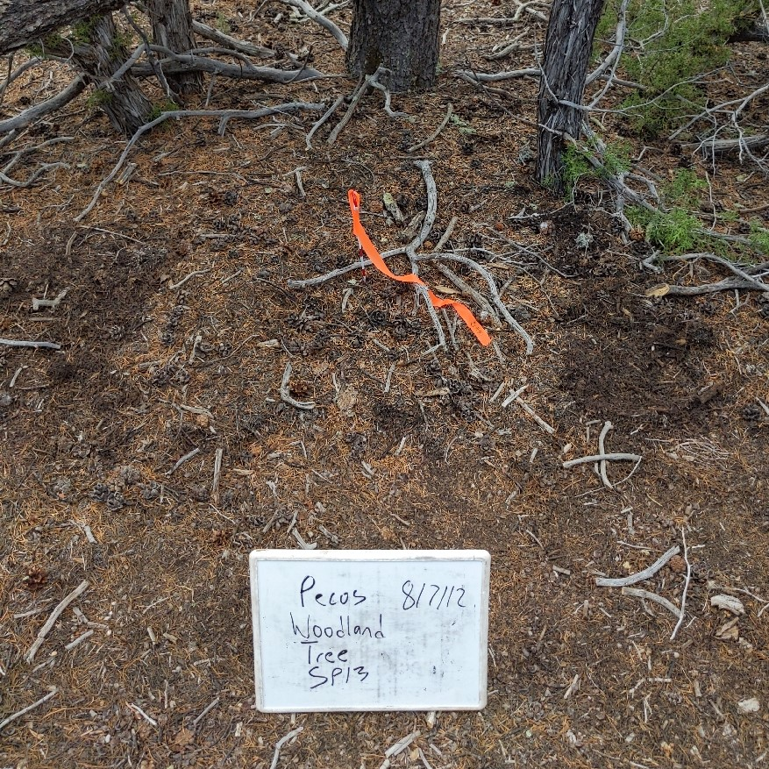
Results
Woodland Ecological Structure – Characterize ground cover across tree and interspace microsites for the woodland
Interspace Microsite
Tree Microsite

Slide 9
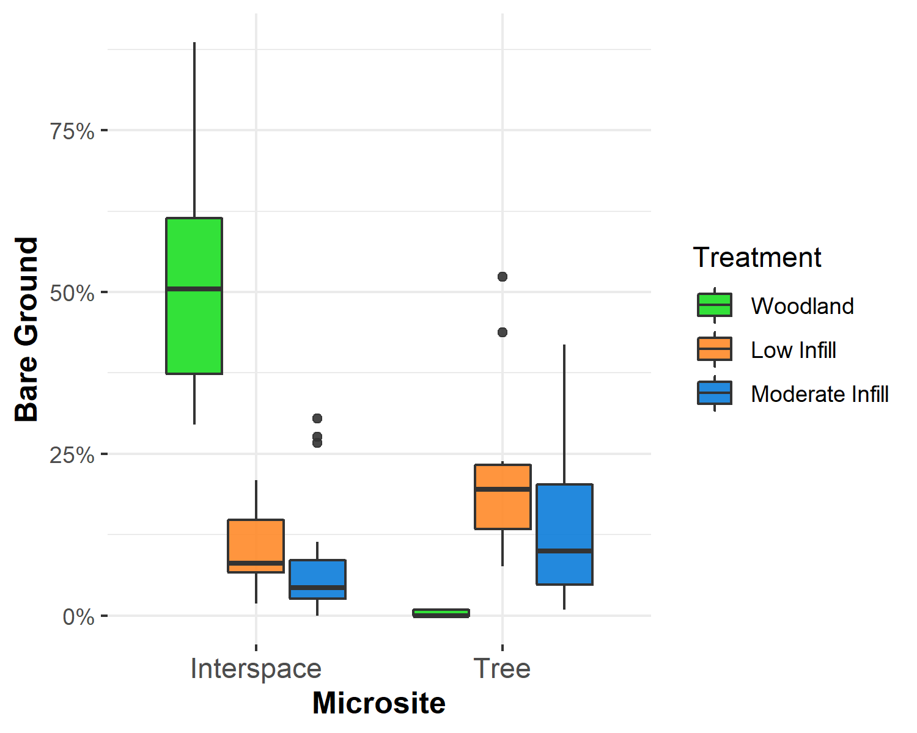
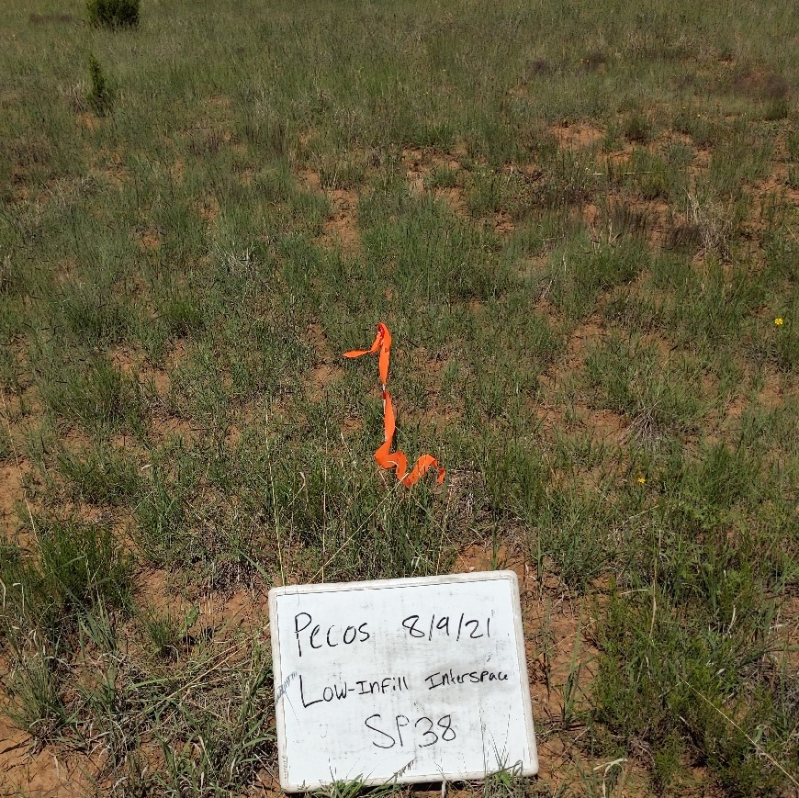
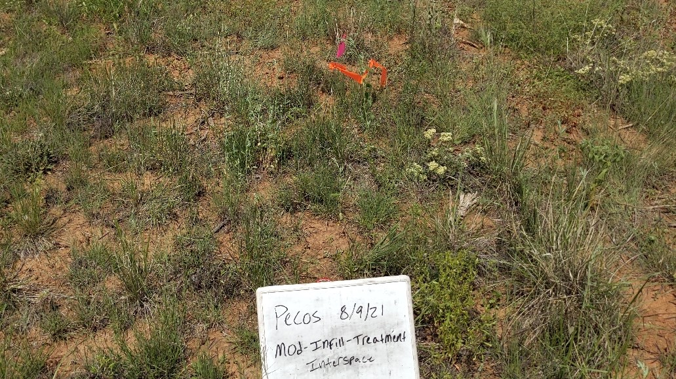
Results
Assess long-term eco-hydrologic impacts – How do microsite level cover change in response to tree removal
Woodland : Interspace
Low Infill : Interspace
Moderate Infill : Interspace

Slide 10
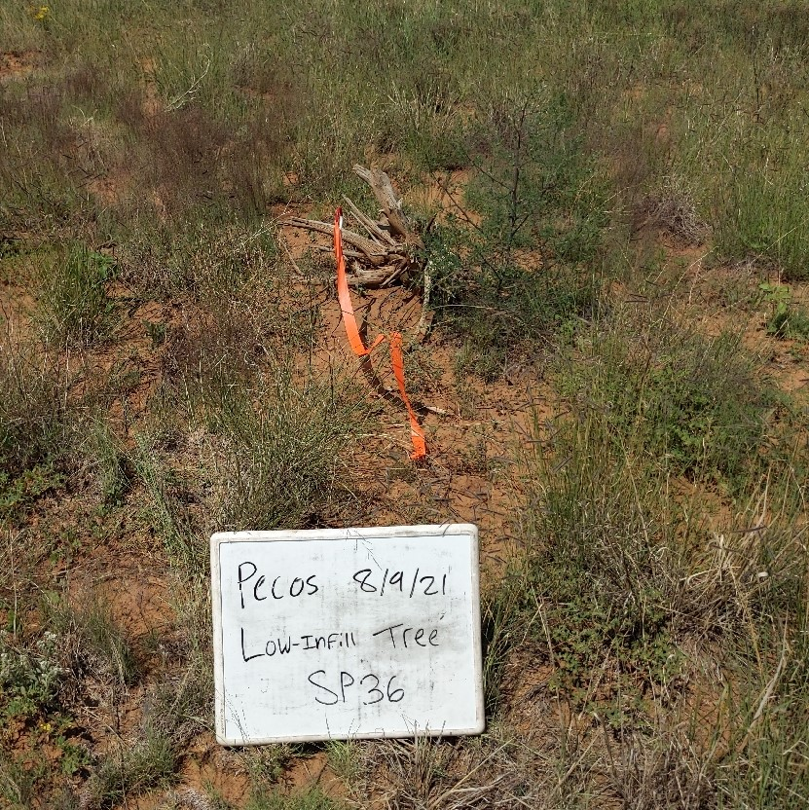
Results
Assess long-term eco-hydrologic impacts – How do microsite level cover change in response to tree removal
Woodland : Tree
Low Infill : Tree

Slide 11
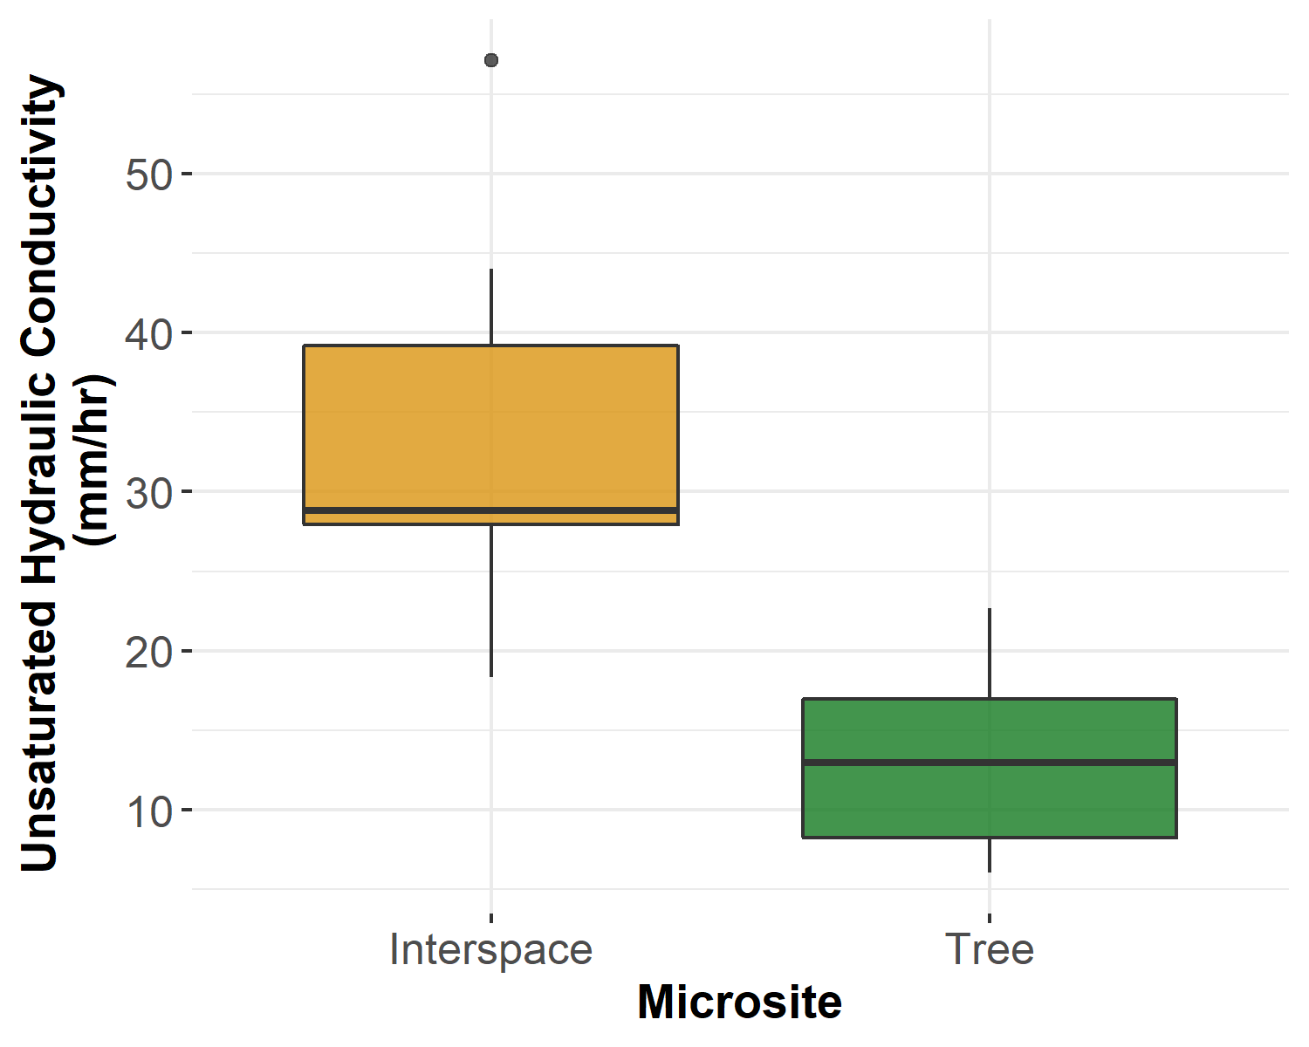
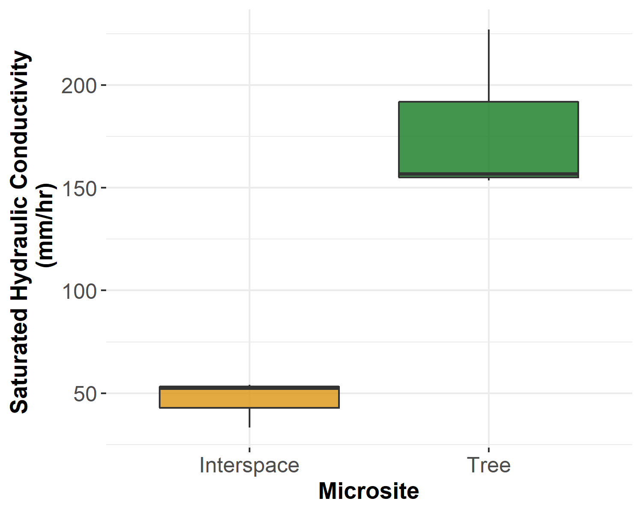
Results
Woodland Hydrologic Function – Characterize infiltration across tree and interspace microsites for the woodland
Unsaturated Hydraulic Conductivity
Measure micropore infiltration
Influenced by water repellency
Saturated Hydraulic Conductivity
Measure macropore and micropore infiltration

Slide 12
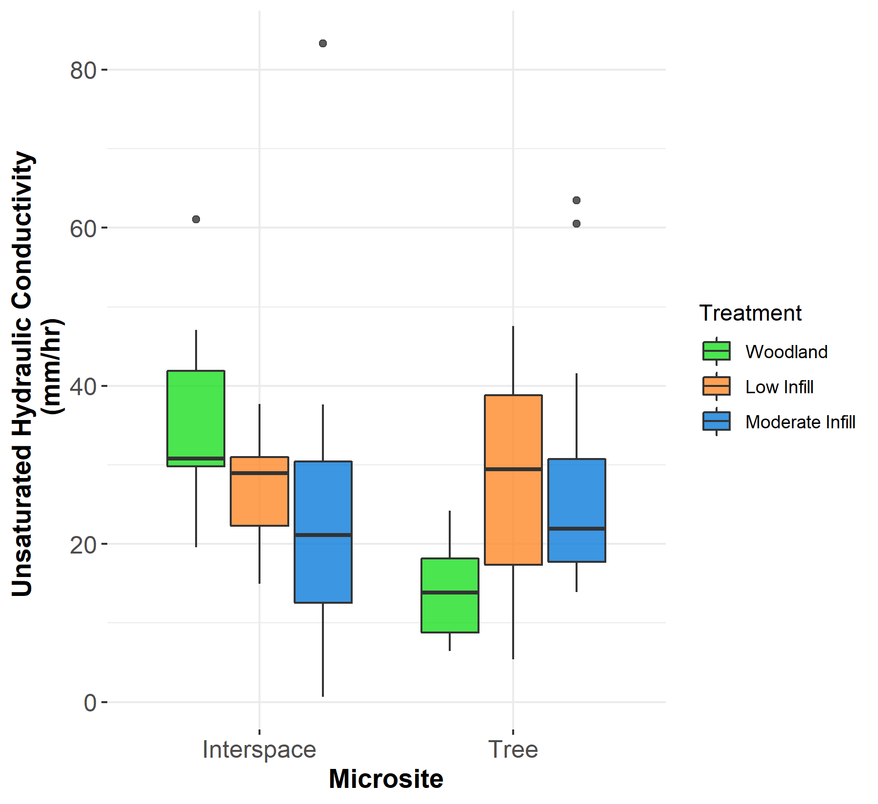
Results
Assess long-term eco-hydrologic impacts – How do microsite level infiltration change in response to tree removal
Unsaturated Hydraulic Conductivity
Interspace Microsite:
Slight decrease in infiltration in cleared woodlands
Tree Microsite:
WDPT – wettable across low infill and moderate infill treatments
Infiltration increases in cleared woodlands due to less water repellency

Slide 13
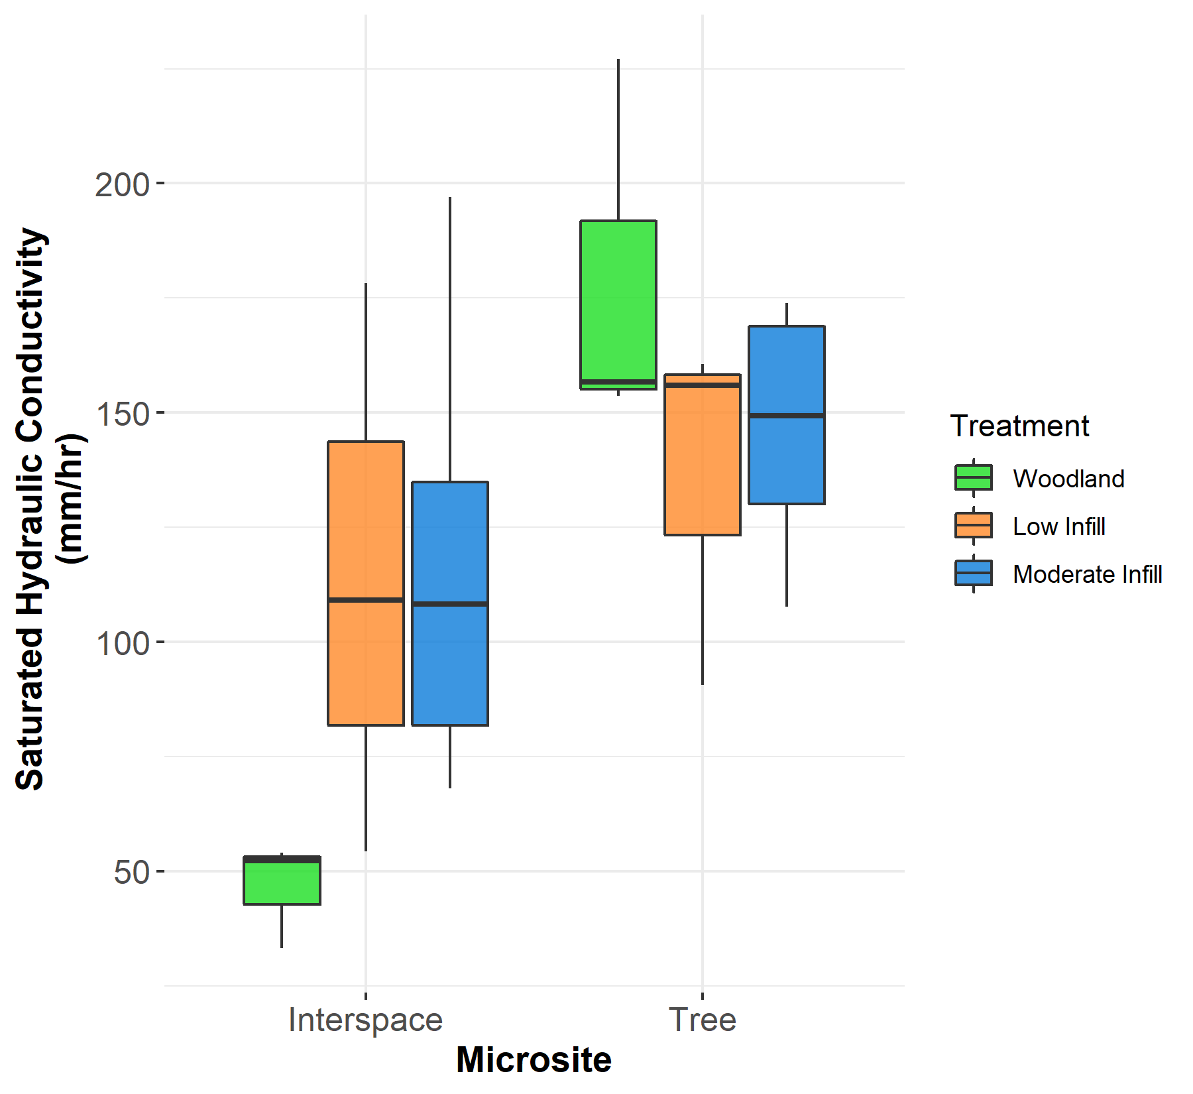
Results
Assess long-term eco-hydrologic impacts – How do microsite level infiltration change in response to tree removal
Saturated Hydraulic Conductivity
Interspace Microsite:
Increase infiltration after tree removal
More macropores in cleared woodlands due to increase in vegetation
Tree Microsite:
Decrease infiltration after tree removal
Macropores slightly filling in

Slide 14
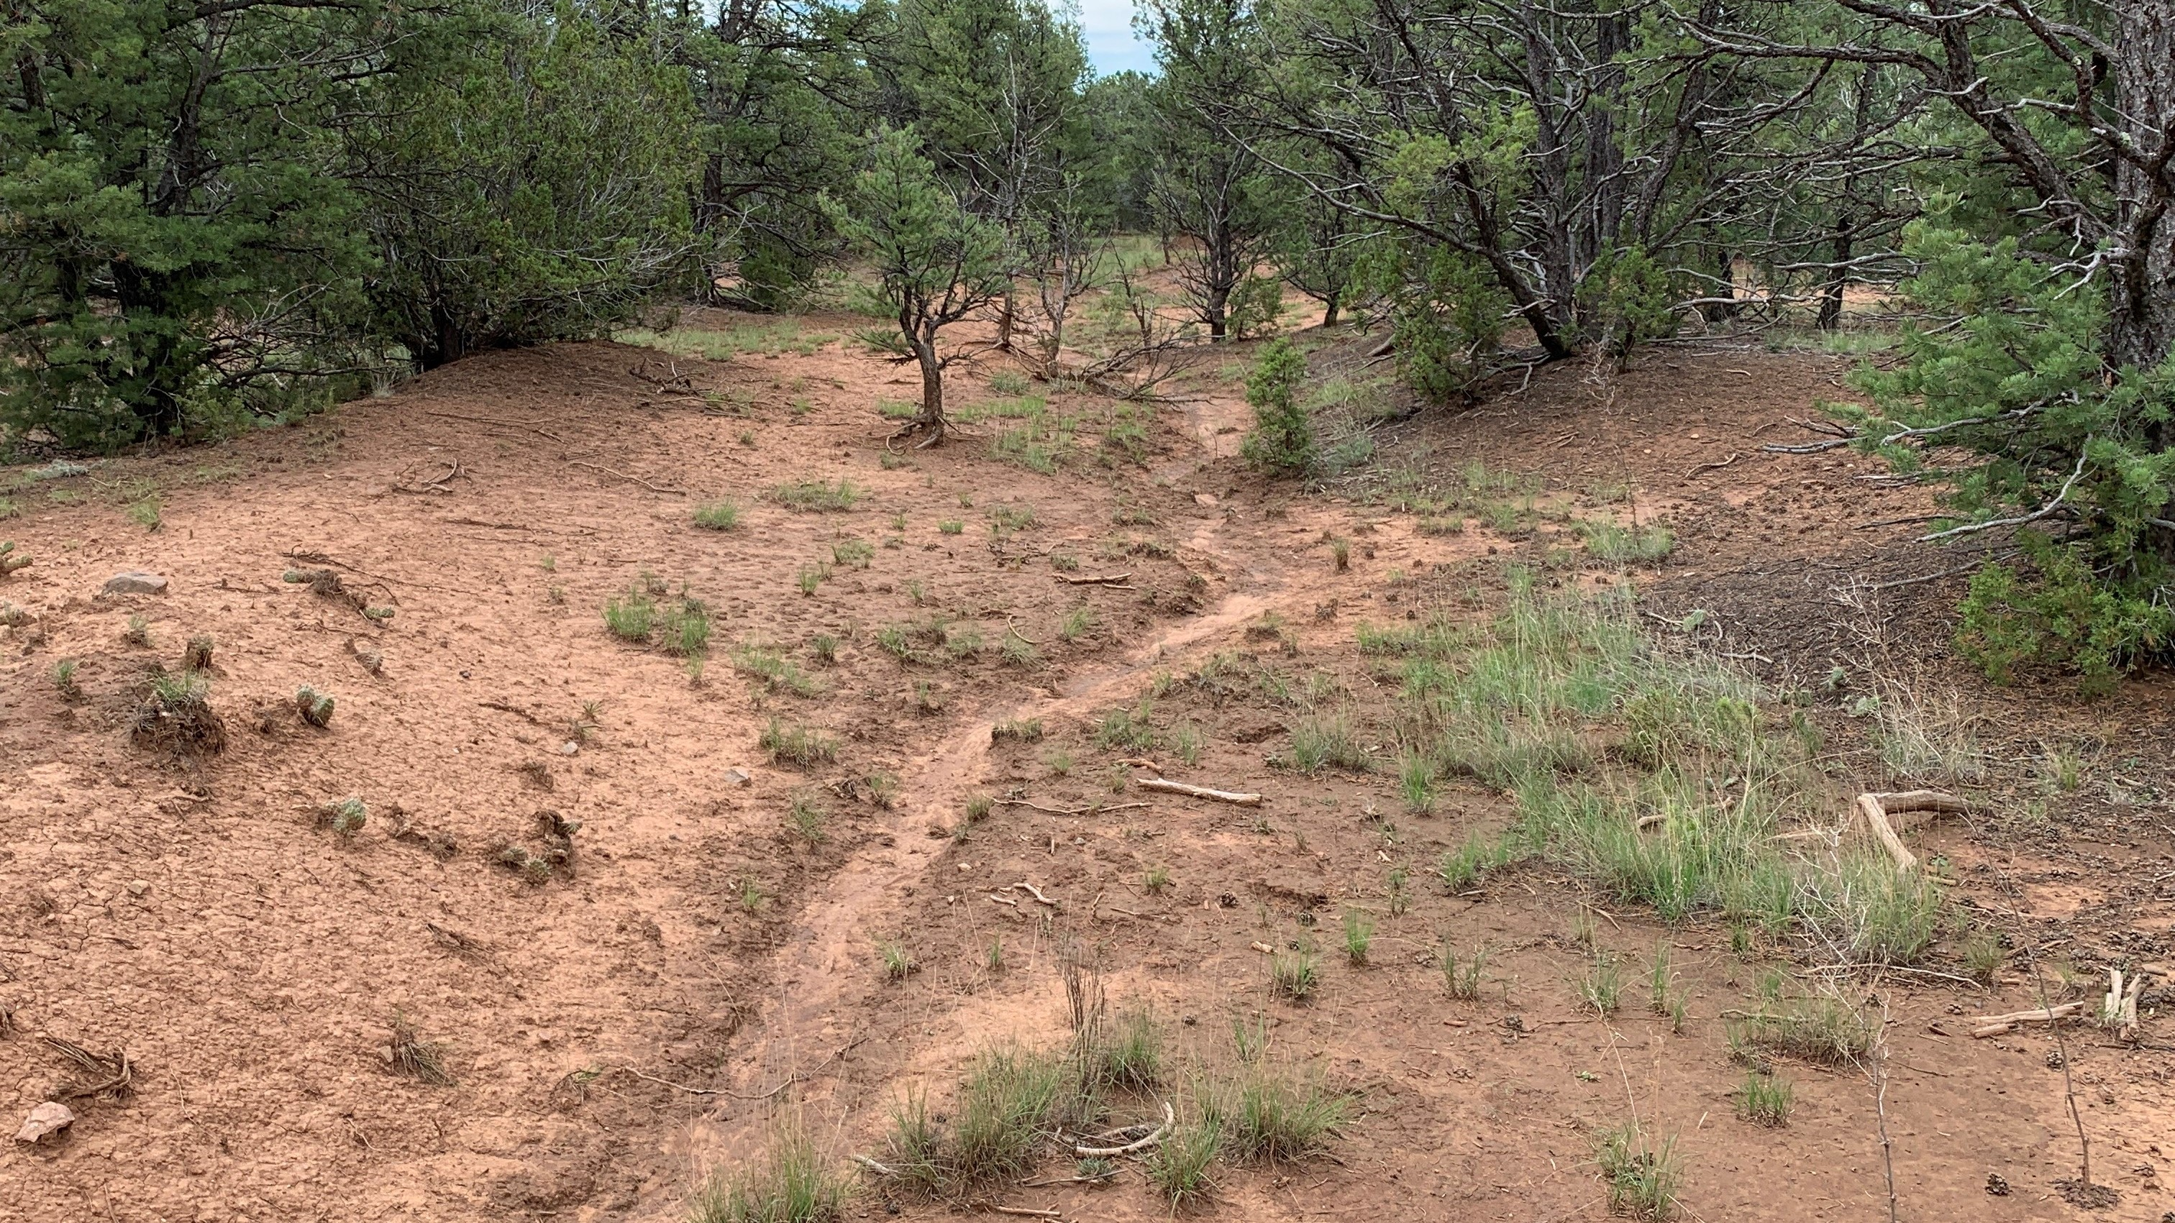
Conclusion
Intact woodlands consist of: →Interspace - sparsely vegetated, limited soil macropores, poor infiltration, and high runoff/erosion vulnerability → tree - litter covered, water repellent soils, but good infiltration associated with macropores
Cleared woodlands consist of: →Increased vegetation in tree and interspace microsites - Vegetation regulates runoff and erosion →More infiltration capacity in interspace microsites →Less vulnerable sites where runoff and erosion occurs
Impact:
This research can advise land managers about what they might expect in terms of vegetative response and erosion rates from a treatment under similar conditions

Slide 15
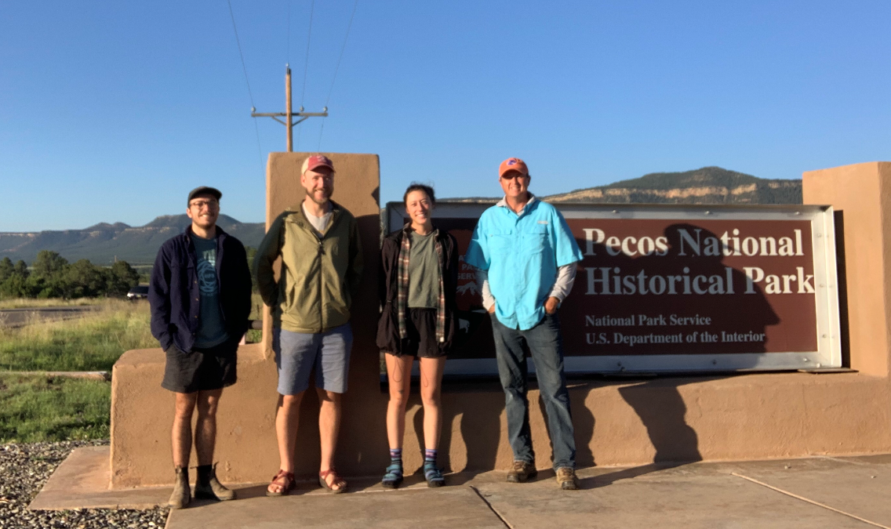
Acknowledgements
Dr. Jason Williams
Justin Johnson
Eric Lassance
Jeremy Moss
Dr. Phil Guertin
University of Arizona field technicians
Arizona/NASA Space Grant Consortium

Slide 16
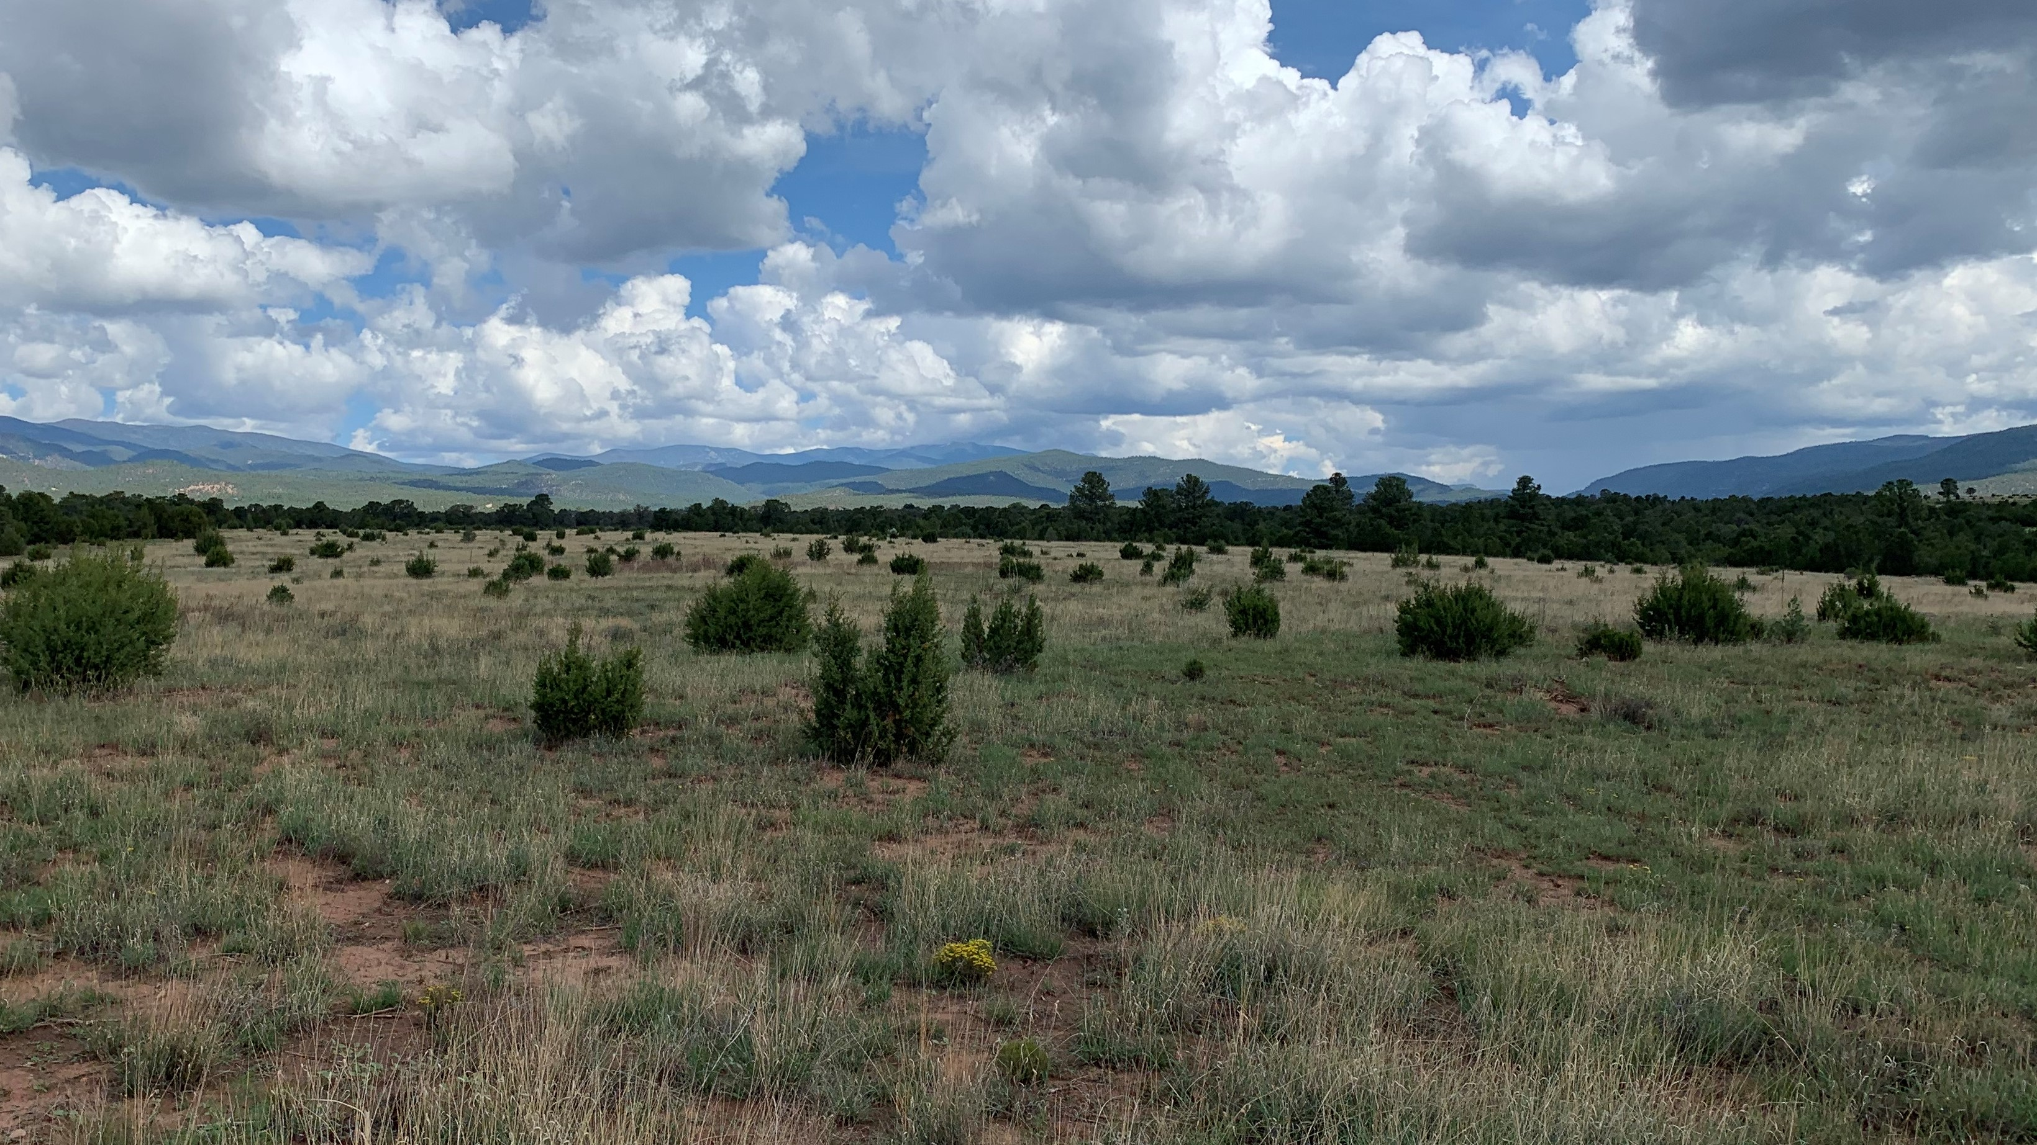
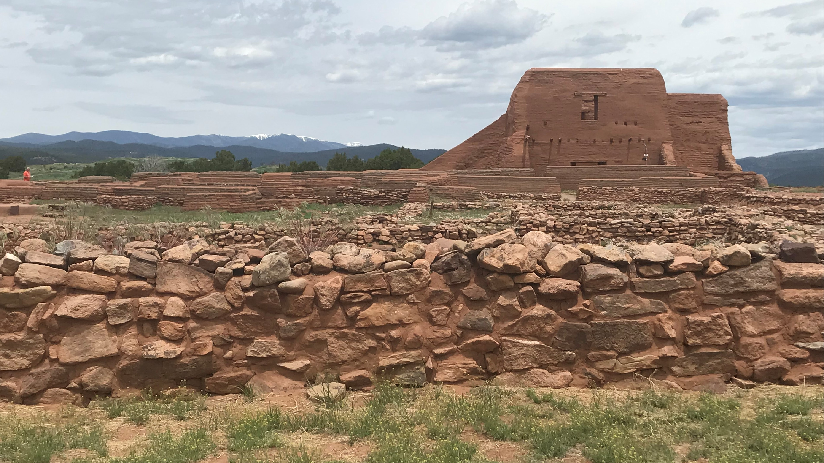
Thank You

